Slide 1
Chapter 5
Final Consumers and Their Buying Behavior
Notes:
For use only with Perreault/Cannon/McCarthy texts.
© 2019 McGraw-Hill Companies, Inc.
CHAPTER FIVE
Lecture Notes for
Essentials of Marketing 16e

Slide 2
At the end of this presentation, you should be able to:
describe how economic needs influence the buyer decision process.
understand how psychological variables affect an individual’s buying behavior.
understand how social influences affect an individual’s buying behavior.
describe how culture and ethnicity influence consumer buying behavior
Notes:
At the end of this presentation, you should be able to :
describe how economic needs influence the buyer decision process.
understand how psychological variables affect an individual’s buying behavior.
understand how social influences affect an individual’s buying behavior.

Slide 3
At the end of this presentation, you should be able to:
explain how characteristics of the purchase situation influence consumer behavior.
explain the process by which consumers make buying decisions.
understand important new terms.
Notes:
At the end of this presentation, you should be able to:
explain how characteristics of the purchase situation influence consumer behavior.
explain the process by which consumers make buying decisions.
understand important new terms.

Slide 4
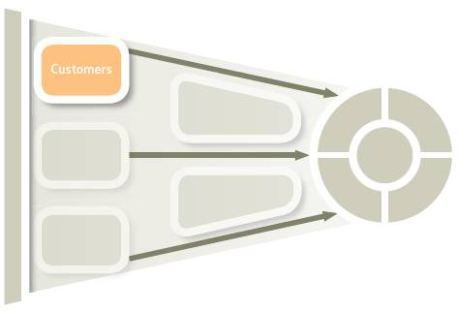
Consumer Behavior for Marketing Strategy Planning (Exhibit 5-1)
Final Consumers
Organizational
Consumers
Chapter 5
Final Consumers and Their
Buying Behavior
Chapter 6
Business and Organizational Customers and
Their Buying Behavior
Marketing Mixes
Other Stimuli
Person Making Decisions
Economic Needs
Psychological Variables
Social Influences
Culture
Purchase Situation
Consumer Decision Process
Person does or does not purchase
Notes:
Summary Overview
Specific behaviors differ for different people, products, and purchase situations.
Key Issues
The variations in present global markets are countless, leading to impracticality of cataloging possibilities.
→General behavioral frameworks help marketing managers to better understand their specific target markets.
→This chapter deals with developing skills in working within these frameworks by exploring thinking from economics, psychology, sociology, and other behavioral disciplines.
Discussion Question: How do firms acquire the sort of in-depth customer knowledge required for effective marketing strategy?
→Indicates place where slide “builds” to include the corresponding point (upon mouse click).

Slide 5
A Model of Influences on Consumer Behavior (Exhibit 5-2)
Marketing mixes All other stimuli
Person making decision
Economic
needs
Economy of
purchase
Convenience
Efficiency
Dependability
Psychological
variables
Motivation
Perception
Learning
Attitude
Trust
Lifestyle
Social influence
Family
Social class
Reference groups
Culture &
Ethnicity
Ethnicity
Culture
International
Purchase
situation
Purchase
reason
Time
Surroundings
Consumer decision process
Person does or does not purchase (response)
Notes:
Summary Overview
Economics and psychology are often cited as key sources of marketing thought, but marketing also derives a great deal of knowledge about consumer behavior from sociology, anthropology, and other social sciences. The basic model of consumer behavior shown here integrates many of these influences.
Key Issues
Economic buyers: people who know all the facts and logically compare choices to get the greatest satisfaction from spending their time and money.
→ Economic needs: those needs that are concerned with the consumer making the best use of his or her time and money.
→ Psychological variables: things that are going on in the mind of the consumer that affect purchase.
Examples: attitudes, personality, learning processes, trust, and perceptions.
Social influences: have to do with the associations that the buyer might have with other people.
Examples: culture, social class, and family influences.
Culture & Ethnicity: cultural influences include a consumer’s ethnic background and international factors.
Purchase situation factors: reason for the purchase, time pressure involved, and surroundings of the purchase.
Discussion Question: How might your purchase of a product be different if you have little time to make your purchase decision as opposed to having unlimited time?
→ Marketing mixes also affect this process.
All other stimuli and influences have an impact on the problem solving process.
→ Outcome of the process might or might not be a purchase.
Economic conditions affect consumer confidence and spending.
→ Indicates place where slide “builds” to include the corresponding point (upon mouse click).

Slide 6
Economic Needs Affect Most Buying Decisions
Economic Buyers
Decide to buy based on
Economic Needs
Economy of purchase or use
Efficiency in operation or use
Dependability in use
Improvement of earnings
Convenience
Notes:
Summary Overview
Most economists assume that consumers are economic buyers—people who know all the facts and logically compare choices to get the greatest satisfaction from spending their time and money.
Key Issues
→Economic-buyer theory says that consumers decide what to buy based on economic needs.
These needs are concerned with making the best use of a consumer’s time and money.
→Some economic needs include:
economy of purchase or use,
efficiency in operation or use,
dependability in use,
improvement of earnings, and
convenience.
→Indicates place where slide “builds” to include the corresponding point (upon mouse click).

Slide 7

Income Affects Needs
All text and images are copywritten with permission from GEICO.
Notes:
Text Caption: Economic needs affect many buying decisions. GEICO knows that some customers are looking for low rates when shopping for car insurance.
Summary Overview
The ability to satisfy economic needs largely depends on how much money a consumer has available—which in turn depends a great deal on household income.
Key Issues
→Economic needs affect many buying decisions, but for some purchases the behavioral influences on a consumer are more important.
→In the United States, income distribution varies widely.
In most households, people don’t have enough income to buy everything they want. For many products, these people cannot be customers even if they want to be.
A family’s purchase of “luxuries” comes from discretionary income—what is left of income after paying taxes and paying for necessities.
Discussion Question: High-speed Internet service that is purchased out of discretionary income by a lower-income family (luxury) may be considered a necessity by a higher-income family. Can you think of more such products?
→Indicates place where slide “builds” to include the corresponding point (upon mouse click).

Slide 8

Economic Needs Affect Many Buying Decisions—But They’re Not the Whole Story
Source: General Motors Company, Chevrolet
Notes:
Text Caption: Dependability is another economic need that car shoppers seek out. Chevrolet wants its target market to know that its Malibu won awards for initial quality and long-term dependability.
Summary Overview
Economic needs help marketers to understand the who, what, when, and where of many aspects of consumer buying behavior. However, economic needs often don’t tell the full story. So marketers have turned to other behavioral sciences in order to consider the full range of buying influences.
Key Issues
Consumers sometimes behave in ways that are consistent with the economist’s idea of an economic buyer—a consumer who has all the facts and makes logical choices to purchase goods and services that will best fulfill his or her needs.
Customers’ incomes are likely to affect their needs—how much money does a customer have available drives his or her buying behavior.
For many marketers, they need to determine their target market’s discretionary income—what is left of income after paying taxes and paying for necessities.
It is certainly true that economic needs affect many buying decisions. Many consumers face budget constraints, and even when they don’t they usually pay attention to factors such as the cost to acquire and use a product, dependability, convenience, how long it will last, and the like.
In explaining the behavior of individual consumers, the economic and/or rational view is useful, but probably too simplistic.
Discussion Question: How does the purchase of a car for an individual’s private use differ from the purchase of a car by a business outfitting its fleet of “company cars”? In which case would economic or rational needs be more important? Why?

Slide 9

Psychological Influences within an Individual
Needs
Wants
©Shutterstock / Monkey Business Images
Drives
Consumers seek benefits to match
needs and wants!
Notes:
Summary Overview
Marketers who follow the marketing concept are concerned with satisfying the needs of consumers, but what exactly are needs, and what types of needs are there?
Key Issues
→ Needs: basic forces that motivate consumers to do something.
Wants: learned needs; that is, they are needs expressed as a desire for a particular need-satisfier.
Discussion Question: What are some of the possible underlying needs and wants for (a) deodorant; (b) a television; and (c) a tax preparation service?
→ Drive: a strong internal stimulus that encourages action to reduce a need.
Consumers seek benefits to meet their needs.
→ Indicates place where slide “builds” to include the corresponding point (upon mouse click).

Slide 10
The PSSP Hierarchy of Needs (Exhibit 5-4)
Personal
Needs
Social Needs
Safety Needs
Physiological Needs
Notes:
Summary Overview
Many different levels of needs can appeal to or motivate a person. The PSSP pyramid shown here helps apply motivation theory to the particular needs of consumers and marketing managers trying to develop marketing mixes to meet those needs.
Key Issues
→ Physiological needs: the most basic needs people experience.
Examples: biological needs for food, liquid, rest, and sex.
→ Safety needs: concerned with protection and physical well-being.
Examples: health, medicine, exercise, and security.
→ Social needs: derived from a person’s interactions with others.
Examples: love, friendship, status, esteem, and connecting with others.
→ Personal needs: concerned with an individual’s need for personal satisfaction, unrelated to what others do.
Examples: personal satisfaction, accomplishment, fun, freedom, and relaxation.
Discussion Question: Can you provide an example of products or services whose marketing mixes attempt to fulfill the four types of needs?
NOTE: Some products may try to satisfy only one type of need, while others may attempt to satisfy more than one type.
→ Indicates place where slide “builds” to include the corresponding point (upon mouse click).

Slide 11

A New Role for Yogurt
Click on play button to view video
Notes:
This United Kingdom ad informs consumers that the active culture (healthy bacteria to aid with digestion) in Dannon’s Activia yogurt will assist in taking care of the consumer’s “inner self.”
Discussion Question: What type of need is Dannon’s Activia trying to satisfy? What type of advertising campaign would you have developed for Dannon’s Activia yogurt?
Video Operation:
INTERNET CONNECTION REQUIRED
Clicking on the orange circle image will open a web browser and access this video. When the video is completed, you can close or minimize the browser and return to the PowerPoint slides.

Slide 12
Checking Your Knowledge
An individual’s insistence on buying Johnson & Johnson’s bath soap for his or her toddler can be termed as a:
social need
want
safety need
drive
psychological need
Notes:
Checking Your Knowledge
Answer: B
Feedback: The discussion of psychological influences on individual buying behavior explains that need is a basic force that motivates people to take a particular action. However, insistence on using a specific product to satisfy a need turns that need into a want. Thus, in this particular case, the parent’s insistence on using a specific product to bathe his or her baby makes option B the correct choice.

Slide 13
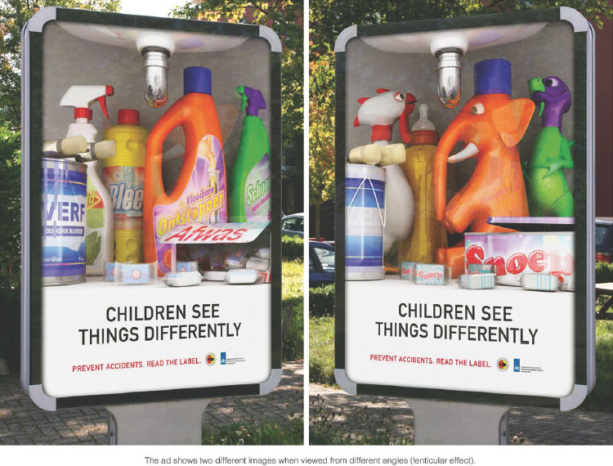
Need Perception
Source: eiligheidNL; Agency: Lemz/Netherlands
Notes:
Text Caption: See below.
Summary Overview
Consumers select varying ways to meet their needs sometimes because of differences in perception—how we gather and interpret information from the world around us.
Key Issues
→Selective processes applied:
Selective exposure—our eyes and minds seek out and notice only information that interests us.
Selective perception—we screen out or modify ideas, messages, and information that conflict with previously learned attitudes and beliefs.
Selective retention—we remember only what we want to remember.
→The Consumer Safety Institute in the Netherlands wants to remind parents that children see those cleaning supplies under the sink differently. As consumers approached this outdoor ad, the image changed from the one on the left to the one on the right (and back).
Discussion Question: Discuss why some people are not affected by some advertising—even ads that are offensive.
→Indicates place where slide “builds” to include the corresponding point (upon mouse click).

Slide 14
The Learning Process (Exhibit 5-5)
Drive
Cues
Reinforcement
Response
Notes:
Summary Overview
Learning is a change in a person’s thought processes caused by prior experience.
Key Issues
→A number of steps are described in the learning process.
As already mentioned, drive is a strong stimulus that encourages action.
→ Depending on the cues—products, signs, ads, and other stimuli in the environment—an individual chooses some specific response.
→ Response is an effort to satisfy a drive.
The response chosen depends on the person’s past experience and the cues.
→ Reinforcement of the learning process occurs when the response is followed by satisfaction—reduction in the drive.
Repeated reinforcement leads to development of a habit—making the individual’s decision process routine.
Discussion Question: Discuss how marketing managers of a particular firm have used the learning process to develop a best-selling product.
→Indicates place where slide “builds” to include the corresponding point (upon mouse click).

Slide 15
Attitudes Relate to Buying
Belief: An Opinion
Attitude: A Point of View
“Green” Attitudes and Beliefs
Key Issues
Building Consumer Trust
Changing Negative Attitudes
Meeting Expectations Is Important
Ethical Issues May Arise
Notes:
Summary Overview
An attitude is a person’s point of view about something. Attitudes tend to be learned. They shape information processing in the consumer’s mind. Attitudes also relate to buying decisions consumers make. Therefore, marketers do a lot of attitude research.
Key Issues
→ Beliefs: opinions people have about something.
→ “Green” attitudes and beliefs change marketing mixes.
A growing number of consumers believe that they can have a positive effect on the environment if they buy from companies that can help them make “greener” choices.
Discussion Question: Think about the following statements: “I like that LED track light fixture. It use less electricity than the compact fluorescent version.” Which statement is the attitude, and which one is the belief?
→ Most marketers work with existing attitudes.
Consumer attitudes tend to be enduring; it’s usually more economical for marketers to work with them than try to change them.
Changing negative attitudes is probably the most difficult job marketers face.
→ Ethical issues may arise if marketers promote inaccurate or false beliefs.
→ Expectations: outcomes or events that a person anticipates.
Understanding and meeting expectations are both important in order to build long-term relationships with customers.
→ Building consumer trust builds sales.
Trust is the confidence a person has in the promises or actions of another person, brand, or company.
Trust drives expectations, because when people trust, they expect the other party to fulfill promises or perform capably.
Trust can be very important in some purchase situations.
→ Indicates place where slide “builds” to include the corresponding point (upon mouse click).

Slide 16

Psychographics Focus on Activities, Interests, and Opinions
Activities
Interests
Opinions
©samot/ 123RF
Notes:
Summary Overview
Personality and lifestyles are other psychological variables that affect consumer behavior.
Key Issues
Personality affects how people see things.
Marketers have found it difficult to incorporate personality into the marketing mix.
→ Psychographics or lifestyle analysis:
Activities: identify what people do—they are objectively observable.
Interests: tend to create stronger drives that may pinpoint market opportunities.
Opinions: are the ways in which people feel about things.
By combining opinions with interests and activities, marketers can develop a robust view of certain target market segments.
Discussion Question: It is often said that lifestyle analysis paints a more “human” picture of the target consumer than does a simple demographic description. Why would this be the case?
→ Indicates place where slide “builds” to include the corresponding point (upon mouse click).

Slide 17
Lifestyle Dimensions (Exhibit 5-6)
Dimension | Examples
Activities | Work Hobbies Social events | Vacation Entertainment Club membership | Surfing web Shopping Sports
Interests | Family Home Job | Community Recreation Fashion | Food Media Achievements
Opinions | Themselves Social issues Politics | Business Economics Education | Products Future Culture
Demographics | Income Age Family life cycle | Geographic area Ethnicity Dwelling | Occupation Family size Education
Notes:
Summary Overview
Psychographics or lifestyle analysis is the analysis of a person’s day-to-day pattern of living as expressed in that person’s Activities, Interests, and Opinions—sometimes referred to as AIOs.
Key Issues
→Exhibit 5-6 shows some variables for each of the AIO dimensions, along with some demographics used to add detail to the lifestyle profile of a target market.
→Understanding the lifestyle of target consumers helps in providing ideas for advertising themes.
Discussion Question: With the help of a scenario, discuss how understanding the lifestyle of target consumers adds to a typical demographic discussion.
→Indicates place where slide “builds” to include the corresponding point (upon mouse click).

Slide 18
Social Influences Affect Consumer Behavior
Social Influences
Family Life Cycle
Acceptance of New Ideas by Youngsters
Growing Singles Market
Reallocation for Teens
Empty Nesters
Real Decision Maker
Notes:
Summary Overview
A consumer’s family, social class, and reference groups influences the consumer decision process.
Key Issues
→Relationships with other family members influence many aspects of consumer behavior.
Marital status, age, and the age of any children in the family have an especially important effect on how people spend their income.
→Singles and young couples are more willing to try new products and brands.
Younger families are still accumulating durable goods, such as automobiles and home furnishings. To meet expenses, people in this age group often make more purchases on credit, and they save less of their income.
→With more people choosing to remain single and others getting divorced, more Americans and Europeans now live alone. This trend opens new markets for firms. Example: IKEA has seen significant growth in product lines designed for small-space living.
→Once children become teenagers, further shifts in spending occur. American teens currently spend almost $200 billion a year. They are a target for many firms.
→Empty nesters are people whose children are grown and who are now able to spend their money in other ways. They spend more on travel and other things they couldn’t afford earlier in life.
→With sex-role stereotypes changed, and with night and weekend shopping more popular, men and older children take more responsibility for shopping and decision making.
Buying responsibility and influence vary greatly depending on the product and the family.
Discussion Question: Give examples for each of the social influences that affect buying decisions.
→Indicates place where slide “builds” to include the corresponding point (upon mouse click).

Slide 19
Family Life Cycle Influences Needs (Exhibit 5-7)
Middle-aged divorced (or single) without children
Young divorced without children
Middle-aged married without children
Young single*
Young married without children*
Young married with children*
Middle-aged married with children*
Middle-aged married without dependent children*
Older married*
Older unmarried*
Usual flow
Young divorced (or single) with children
Middle-aged divorced with children
Middle-aged divorced without dependent children
Recycled flow
* Traditional
family flow
Notes:
Summary Overview
Relationships with other family members influence many aspects of consumer behavior.
The exhibit shows a summary of stages in the family life cycle.
Key Issues
The traditional family life cycle flow from young and single, to getting married, and adding children who grow up and later leave home.
Increasingly, many Americans are choosing not to have children.
Another growing family life cycle pattern involves divorce.
→ Indicates place where slide “builds” to include the corresponding point (upon mouse click).

Slide 20
Family Life Cycle
5-20
Click on play button to view video
Notes:
The McDonald’s ad compares the complicated and changing elements of life to the simple meal solution of cheese, hamburger, and bun.
Video Operation:
INTERNET CONNECTION REQUIRED
Clicking on the orange circle image will open a web browser and access this video. When the video is completed, you can close or minimize the browser and return to the PowerPoint slides.

Slide 21
Checking Your Knowledge
A travel and tour operator has announced luxury vacation packages to various destinations across the globe. The package includes overnight stays at opulent resorts and services from posh spas. Which of the following is most likely to be the target customer base for this tour operator?
Teenagers
Single parents
Middle-aged married with children
Middle-aged married without dependent children
Young-married with children
Notes:
Checking Your Knowledge
Answer: D
Feedback: The discussion of social influences on individual buying behavior explains that people whose children are grown or are not dependent on them (empty nesters) have more disposable income. This tends to be a high-income period, especially for white-collar workers. Empty nesters are an attractive market for many items. Often they spend more on travel and other things they couldn’t afford earlier in life. This makes option D the most suitable target market for the travel company

Slide 22




Simple Approaches for Measuring Social Class in the United States
Occupation
Education
Type of Housing
Location of Housing
Income Is Not the Main Determinant!
Sources: ©VMJones/Getty Images; Visage/Getty Images; Getty Images; ©ac productions/Blend Images LLC
Notes:
Summary Overview
Perceived and actual social standing have powerful influences on consumers. It is important to remember when considering these influences that the person chosen or appointed to fill each social influence role is largely determined by the social class to which the consumer belongs.
Key Issues
Social Influences
Social class: a group of people who have approximately equal social position as viewed by others in the society.
What do these classes mean?
→ In the United States, income is not the main determinant of social class.
People with similar incomes can be in different social classes because of their occupation, education, and type or location of housing.
Discussion Question: How might differences in social classes translate into (a) differences in buying behavior and (b) different marketing mix tactics?

Slide 23


Other Social Influences
Reference Groups
©Shutterstock / Pressmaster
Opinion Leaders
©Shutterstock / WHYFRAME
Notes:
Summary Overview
There are other key social influences on buying behavior.
Key Issues
→ Reference group: the people to whom an individual looks when forming attitudes about a particular topic.
Discussion Question: Can you provide some examples of reference groups to which you belong now or wish to belong in the future?
→ Opinion leaders: people who influence others.
Their influence matters because of some characteristic they have.
Can provide important word-of-mouth advertising, if marketers reach the opinion leaders who are buyers.
Marketers can use opinion leaders as official endorsers for their market offerings.
→ Indicates place where slide “builds” to include the corresponding point (upon mouse click).

Slide 24
Culture, Ethnicity, and Consumer Behavior
Culture
Consumer Behavior
International Markets
Ethnic Groups
Stereotypes
Notes:
Summary Overview
Cultural variation across ethnic groups or countries can result in differences in how consumers make purchase choices.
Key Issues
→Culture is the set of beliefs, attitudes, and ways of doing things of a homogeneous set of people.
People within cultural groupings tend to be more similar in outlook and behavior.
→People from different ethnic groups may be influenced by different cultural variables. This creates both opportunities and challenges for marketers.
→Many firms make the mistake of treating all consumers in a particular ethnic group as homogeneous. More marketers pay attention to ethnic groups now because the number of ethnic consumers is growing at a much faster rate than the overall society.
Marketers must respond to the trend of growing number of Hispanics and Asian Americans.
→Firms that conduct business internationally must plan strategies keeping in mind the varied cultures across borders.
Each foreign market should be treated as a separate market with its own sub-markets.
Understanding different cultures also leads to innovative methods for blending the four Ps.
Discussion Question: Discuss how the marketing of a product is adapted to suit Hispanic markets and American markets.
→Indicates place where slide “builds” to include the corresponding point (upon mouse click).

Slide 25
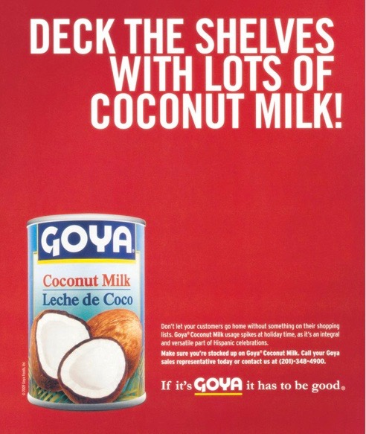
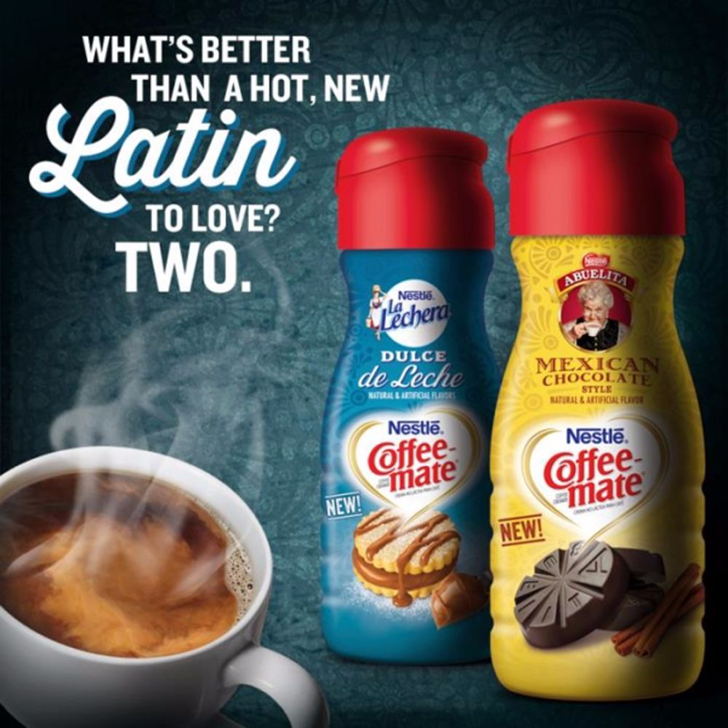
Consumer Behavior in International Markets
Source : Goya Foods, Inc
Source: Nestlé S.A
Notes:
Text Caption: See below
Summary Section
The less a marketing manager knows about the specific social and intrapersonal variables that shape the behavior of target customers, the more likely it is that relying on intuition or personal experience will be misleading.
Key Issues
Many firms are developing strategies to appeal to the fast-growing Hispanic market. Goya wants to let grocers know that demand for coconut milk spikes during the holidays because it is a vital part of many Hispanic celebrations. Nestlé's Coffee-Mate brand is bringing flavors popular in Mexico and South America to the United States.
Failure to understand local cultural factors can be the difference between success and failure.
Some cultural factors are as subtle as they are fundamental.

Slide 26

Individuals Are Affected by the Purchase Situation
Purchase Reason
Time Available
Physical Surroundings
©Corbis/SuperStock
Notes:
Summary Overview
The particular situation a consumer is in during or around the time of purchase can also have significant effects on the actual purchase.
Key Issues
Among the key situational influences are:
→ The purchase reason can vary. Why a consumer makes a purchase can affect buying behavior.
→ Time available for the purchase also affects what happens.
Physical surroundings of the purchase affect buying, as do the emotional responses they elicit or encourage.
Discussion Question: Have you ever been in a store known for its sophisticated use of surroundings to enhance sales, such as The Disney Store or Victoria’s Secret? How do these retailers manipulate the surroundings, or “atmospherics,” as a key part of their overall marketing strategy?
→ Indicates place where slide “builds” to include the corresponding point (upon mouse click).

Slide 27
Expanded Model of Consumer Behavior (Exhibit 5-8)
Marketing mixes
Other stimuli
Person Making Decisions
Economic needs
Psychological variables
Social influences
Culture & ethnicity
Purchase situation
Consumer Decision Process
Need awareness
Routinized response
Purchase decision
After-purchase experience
Problem solving
•Information search
•Identify alternatives
•Set criteria
•Evaluate alternatives
Postpone decision
Feedback based on experience
Notes:
Summary Overview
This exhibit illustrates the steps in the consumer decision process and focuses on how consumers make decisions.
Key Issues
→The consumer decision process begins when a consumer becomes aware of an unmet need. The consumer’s problem-solving process then focuses on how best to meet that need.
The web and social media raise awareness of needs. Consumers who see friends and family addressing certain needs may find themselves with new needs and wants.
→How a consumer solves the problem depends on the situation.
A consumer may search for information, identify alternatives, decide what factors (criteria) are important, and then evaluate one or more alternative products to meet the need.
Consumers use extensive problem solving when they put much effort into deciding how to satisfy a need.
The problem solving continuum goes from
routinized response behavior, which is used when a consumer regularly selects a particular way of satisfying a need when it occurs, to
limited problem solving, which is used by consumers when some effort is required in deciding the best way to satisfy a need, to
extensive problem solving, which is when consumers put much effort into deciding how to satisfy a need.
→Consumers don’t always seek information—a routinized response involves little or no information search or identification and evaluation of alternatives—or make smart choices that provide the best economic value because of the influences on consumer behavior.
→Buying can be complicated—and sometimes the complexity of all the choices causes customers to delay the purchase.
→ Consumers that do purchase have a post-purchase experience that may provide feedback and guide their next purchase.
→Indicates place where slide “builds” to include the corresponding point (upon mouse click).

Slide 28
Problem Solving Continuum (Exhibit 5-10)
Low involvement
Frequently purchased
Inexpensive
Little risk
Little information needed
High involvement
Infrequently purchased
Expensive
High risk
Much information desired
Routinized Response Behavior
Limited Problem Solving
Extensive Problem Solving
Low involvement
High involvement
Notes:
Summary Overview
The time, effort, and source of information used in making a purchase can be influenced by the relative level of involvement the consumer experiences.
Key Issues
In extensive problem solving, a consumer attempts to satisfy a completely new or important need.
Much information is needed.
The consumer has no experience.
The decision—and risk of making a wrong decision—are important.
These purchases are often referred to as high involvement purchases.
→ In limited problem solving, the consumer is willing to put forth some effort, perhaps to update or add to previous experience or because the problem is moderately important.
→ In routinized response behavior, a consumer resorts to habit to solve a problem.
These purchases are often referred to low-involvement purchases that have little importance or relevance to the consumer.
The idea of a decision process does not imply that consumers always apply rational processes in their buying decisions.
The consumer problem-solving process doesn’t always lead to a purchase.
Discussion Question: Think about three purchases you have made involving extensive problem solving, limited problem solving, and routinized response behavior, respectively. How did the purchase process differ across the three purchases?
→ Indicates place where slide “builds” to include the corresponding point (upon mouse click).

Slide 29
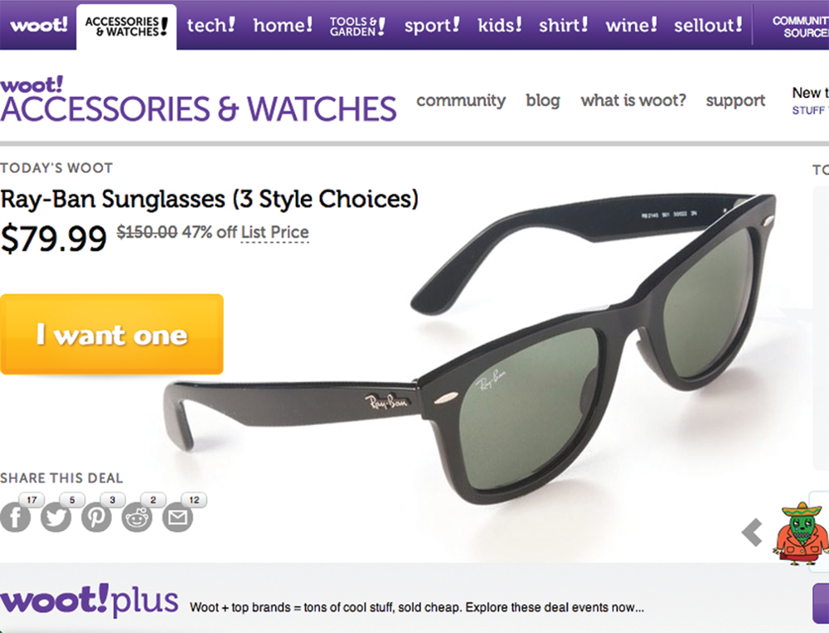
Limited or Extensive Problem Solving?
Source: Woot Inc.
Notes:
Text Caption: See below.
Summary Overview
The time a consumer has available to shop also affects his or her behavior. Woot uses this to its advantage. The online retailer offers one deeply discounted product each day—customers must buy that day or forget about it.
Discussion Question: Is this ad aimed at limited or extensive problem solving consumers?
It would depend on:
the effort the consumer would be willing to expend; and
previous consumer experience in buying sunglasses.
The classification of a purchase decision as extensive problem solving, limited problem solving, or routinized response behavior is something that takes place in the mind of the consumer—not in the mind of the marketer.

Slide 30
Problem Solving
Click on play button to view video
Notes:
As consumers approach the problem-solving process, they bring attitudes formed by previous experiences and social training, unless of course, they face an extensive problem-solving situation. In this “Not Just a Tomato” commercial from Raley’s Bel Air, they inform the consumer about their passion for organic produce.
Video Operation:
INTERNET CONNECTION REQUIRED
Clicking on the orange circle image will open a web browser and access this video. When the video is completed, you can close or minimize the browser and return to the PowerPoint slides.

Slide 31
After-Purchase Experience
After Purchase Experience
Second Thoughts
Spread the Word
Post-Purchase Regret
Notes:
Summary Overview
After making a purchase, buyers go through a variety of emotions including doubt and regret.
Key Issues
→Buyers often have second thoughts and wonder if they made the right choice. The resulting tension is called dissonance—a feeling of uncertainty about whether the correct decision was made.
→A customer gets disappointed when a post-purchase experience fails to live up to expectations.
A consumer may regret making a purchase for a variety of reasons that the consumer didn’t anticipate when making the purchase.
→Many consumers talk about their purchases and share opinions about their good and bad experiences.
A marketer must always remember that a customer is more likely to talk about a bad experience rather than a good one. Many people rely on such information in making purchase choices.
Discussion Question: Mention how reviews of a specific product or service affected its sales.
→Indicates place where slide “builds” to include the corresponding point (upon mouse click).

Slide 32
Predictive Analytics
Needs Awareness
Information Search
Predictive
Analytics
Post-Purchase
Alternatives Identification
Notes:
Summary Overview
Many firms compile data useful for predictive analytics—a process to analyze data to make predictions about unknown future events.
Key Issues
Here are a few examples of how predictive analytics could operate in consumer decision making:
Needs awareness. A sporting goods store might gather mileage data from a customer’s fitness app to predict when the customer will be ready for a replacement set of running shoes.
Information search. Based on a customer’s past car shopping behavior, a website for an automaker could present features the customer is most concerned with.
Alternatives identification. A customer’s Netflix home page offers viewing recommendations based on their past viewing behavior.
Post-purchase. Marketing managers often try to predict if customers will stop using a product. For example, if a cell phone provider knows a customer is considering a switch to a rival network, it could make the customer an offer to keep its service.
Discussion Question: How have predictive analytics factored into a recent decision you made?
→ Indicates place where slide “builds” to include the corresponding point (upon mouse click).

Slide 33
Adoption Process Steps
Awareness
Interest
Evaluation
Dissonance may set in after the decision!
Trial
Decision
Confirmation
Notes:
Summary Overview
Many new product concepts require an adoption process. In these situations, consumers may pass through a series of steps used to investigate and evaluate, and ultimately accept or reject, an idea or product as a solution to their problem.
Key Issues
→ In the awareness stage, the potential customer first learns about the existence of a product but may lack more details.
→ If the interest stage is reached, the consumer will gather general information and facts about the product.
Discussion Question: Would selective processes (described earlier) have an impact on whether the consumer reaches the interest stage? Explain.
→ In evaluation, the consumer gives the product a mental trial, applying it to his or her own personal situation.
→ In trial, the consumer may buy the product to experiment with it in use.
→ The consumer ultimately makes a decision—on either adoption and continued use, or rejection of the product from further consideration.
→ After the decision, there is confirmation. Here the adopter continues to rethink the decision and searches for further support that it was correct.
→ Dissonance may set in after the decision—tension caused by uncertainty about the rightness of a decision.
→ Indicates place where slide “builds” to include the corresponding point (upon mouse click).

Slide 34
Key Terms
economic buyers
economic needs
discretionary income
needs
wants
drive
physiological needs
safety needs
social needs
personal needs
perception
selective exposure
selective perception
selective retention
learning
cues
response
reinforcement
attitude
belief
…….
Notes:
Summary Overview
These are key terms you should be familiar with based upon the material in this presentation.
Key Issues
Economic buyers: people who know all the facts and logically compare choices to get the greatest satisfaction from spending their time and money.
Economic needs: concerned with making the best use of a consumer’s time and money—as the consumer judges it.
Discretionary income: income that is left after paying taxes and necessities.
Needs: basic forces that motivate person to do something.
Wants: “needs” that are learned during a person’s life.
Drive: a strong stimulus that encourages action to reduce a need.
Physiological needs: Concerned with biological needs—food, liquid, rest, and sex.
Safety needs: concerned with protection and physical well-being.
Social needs: concerned with love, friendship, status, and esteem—things that involve a person’s interaction with others.
Personal needs: concerned with an individual’s need for personal satisfaction—unrelated to what others think or do.
Perception: how one gathers and interprets information from the world around.
Selective exposure: seeking out and noticing only that information that interests us.
Selective perception: screening out and modifying ideas, messages, and information that conflict with previously learned attitudes and beliefs.
Selective retention: remembering only that which we want to remember.
Learning: change in a person’s thought processes caused by prior experience.
Cues: products, signs, ads, and other stimuli in the environment.
Response: effort to satisfy a drive.
Reinforcement: occurs when the response is followed by satisfaction—that is, reduction in the drive.
Attitude: a person’s point of view toward something.
Belief: a person’s opinion about something.
.
This slide refers to boldfaced terms appearing in Chapter 5.

Slide 35
Key Terms
expectation
trust
psychographics
lifestyle analysis
empty nesters
social class
reference group
opinion leader
culture
purchase situation
extensive problem solving
limited problem solving
routinized response behavior
low-involvement purchases
dissonance
predictive analytics
adoption process
Notes:
Summary Overview
These are key terms you should be familiar with based upon the material in this presentation.
Key Issues
Expectation: an outcome or event that a person anticipates or looks forward to.
Trust: confidence a person has in the promises or actions of another person, brand, or company.
Psychographics: analysis of a person’s day-to-day pattern of living as expressed in that person’s Activities, Interests, and Opinions.
Lifestyle analysis: same as psychographics.
Empty nesters: people whose children are grown and who are now able to spend their money in other ways.
Social class: group of people who have approximately equal social position as viewed by others in the society.
Reference group: people to whom an individual looks when forming attitudes about a particular topic.
Opinion leader: person who influences others.
Culture: whole set of beliefs, attitudes, and ways of doing things of a reasonably homogeneous set of people.
Purchase situation: takes into account the purchase, time available, and location where a purchase is made.
Extensive problem solving: much effort put into deciding how to satisfy a need.
Limited problem solving: used by consumers when some effort is required in deciding the best way to satisfy a need.
Routinized response behavior: when a consumer regularly selects a particular way of satisfying a need when it occurs.
Low-involvement purchases: that which have little importance or relevance for the customer.
Dissonance: a feeling of uncertainty about whether the correct decision was made.
Predictive analytics: a process used to analyze data to make predictions about unknown future events.
Adoption process: the steps individuals go through on the way to accepting or rejecting a new idea.
This slide refers to boldfaced terms appearing in Chapter 5.

